Slide 1
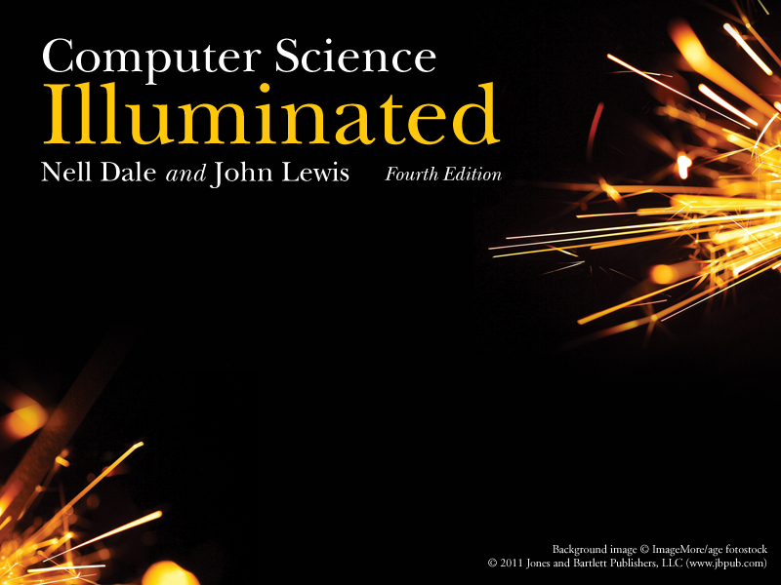
Chapter 11
File Systems
and Directories

Slide 2
Chapter Goals
Describe the purpose of files, file systems, and directories
Distinguish between text and binary files
Identify various file types by their extensions
Explain how file types improve file usage
Define the basic operations on a file

Slide 3
Chapter Goals
Compare and contrast sequential and direct file access
Discuss the issues related to file protection
Describe a directory tree
Create absolute and relative paths for a directory tree
Describe several disk-scheduling algorithms

Slide 4
File Systems
File
A named collection of related data, used for organizing secondary memory
File system
The operating system's logical view of the files it manages
Directory
A named group of files

Slide 5

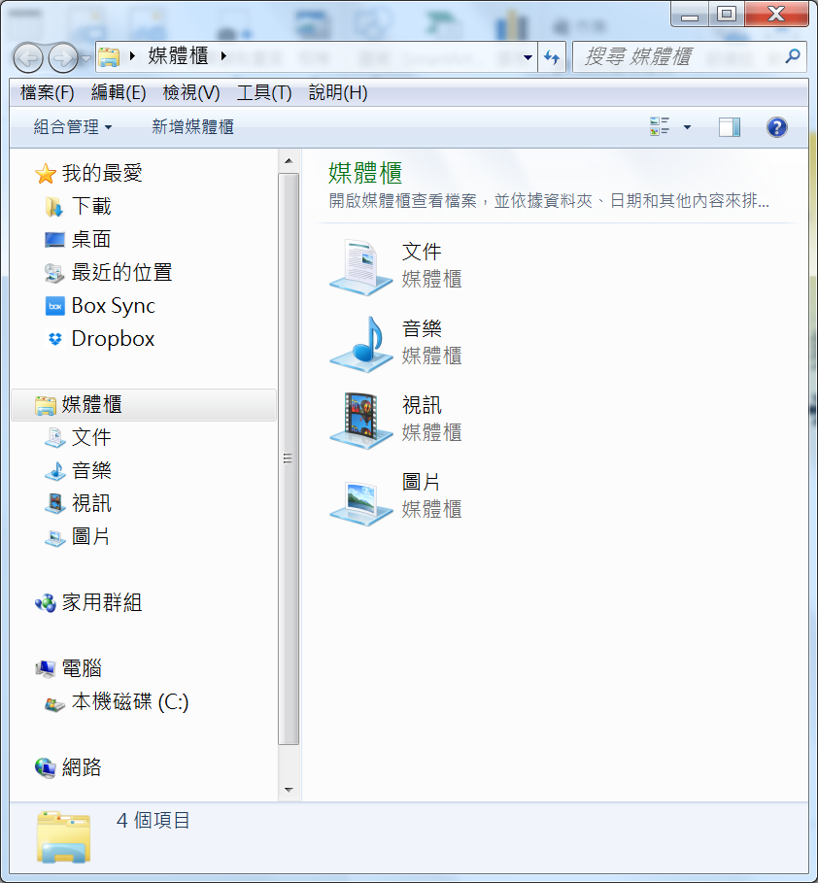
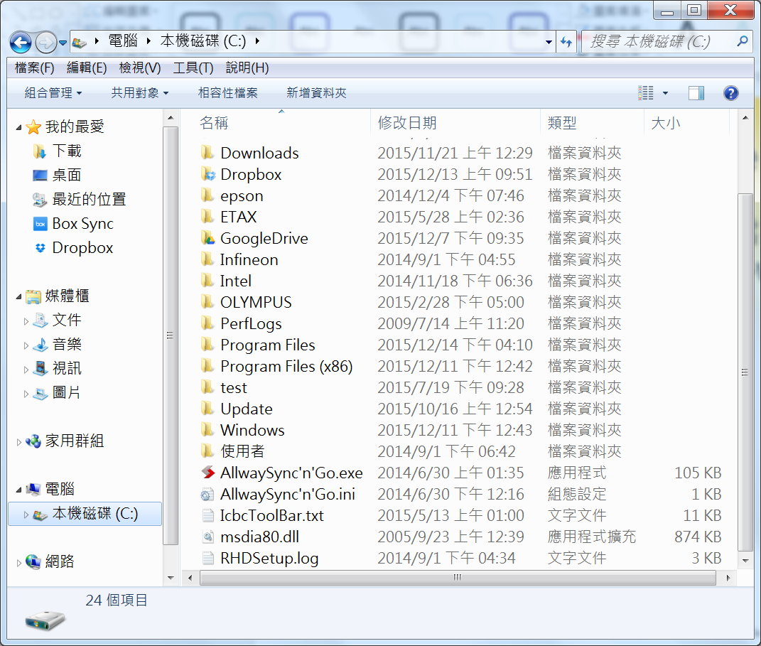
Example of a File System
請執行Windows作業系統的檔案總管
  ➔所有程式➔附屬應用程式➔Windows檔案總管
File System
Directory
File

Slide 6
Text and Binary Files
Text file
A file that contains characters from the ASCII or Unicode character sets
Binary file
A file that contains data in a specific format, requiring special interpretation of its bits

Slide 7
Text and Binary Files
The terms text file and binary file are somewhat misleading
Ultimately, all information on a computer is stored as binary digits
Text files are formatted as chunks of 8 or 16 bits, interpreted as characters
Binary files are formatted in some other special format

Slide 8
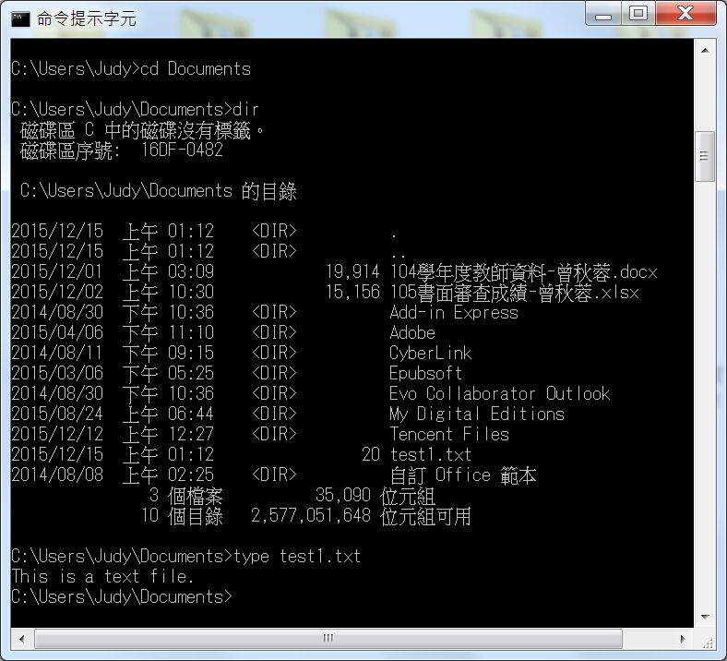
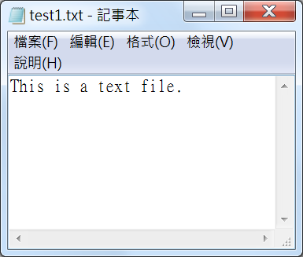
Examples of a Text File
  ➔所有程式➔附屬應用程式➔命令提示字元

Slide 9
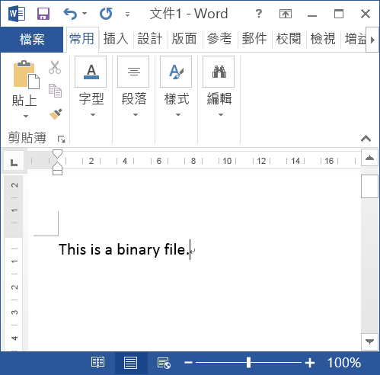
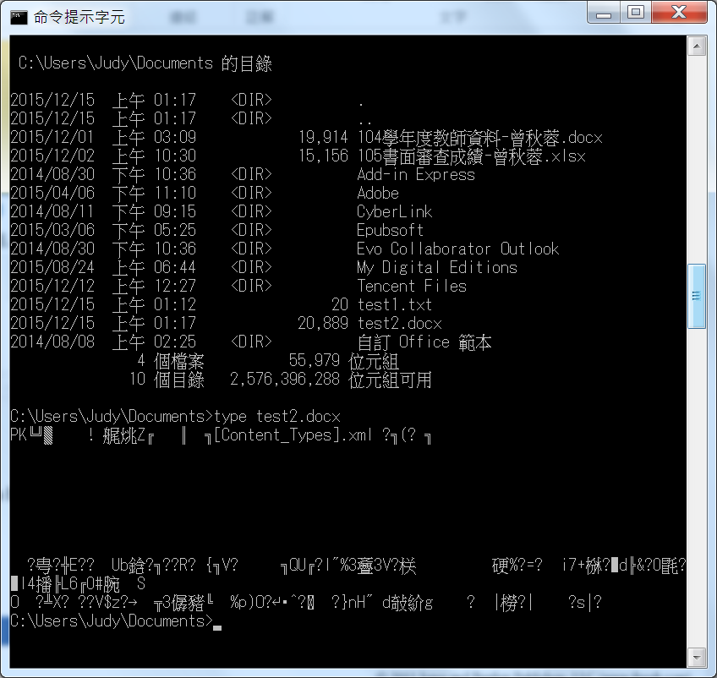

Examples of a Binary File

Slide 10
File Types
File Type
The kind of information contained in a document
Most files, regardless of format, contain a specific type of information
File extension(副檔名)
Part of a file name that indicates the type
File names are often in two parts:
  File name . File Extension

Slide 11
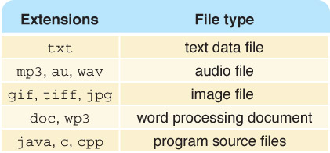
File Types
What kind of files are
  Chapter.doc
  Figure1.jpg
  Interview.wav
  MyFavorite.mp3
Figure 11.1 Some common file types and their extensions
What's the advantage of using the appropriate extension?

Slide 12
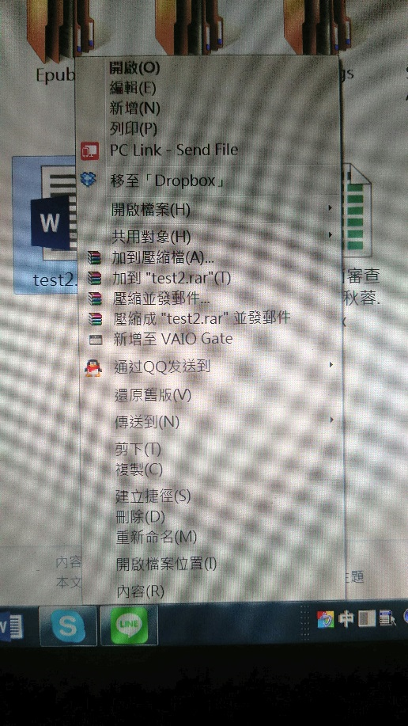
File Operations
What operations do you think you might want to perform on or with a file?
Please put your mouse on any file and press the right button. What file operations do you see?

Slide 13
File Access
Sequential access
The technique in which data in a file is accessed in a linear fashion; to get the last record, you must read all of the records
Direct access
The technique in which data in a file is conceptually divided into numbered logical records and accessed directly, by specifying logical record numbers

Slide 14
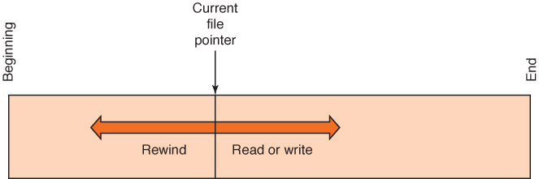
File Access
Figure 11.2 Sequential file access

Slide 15
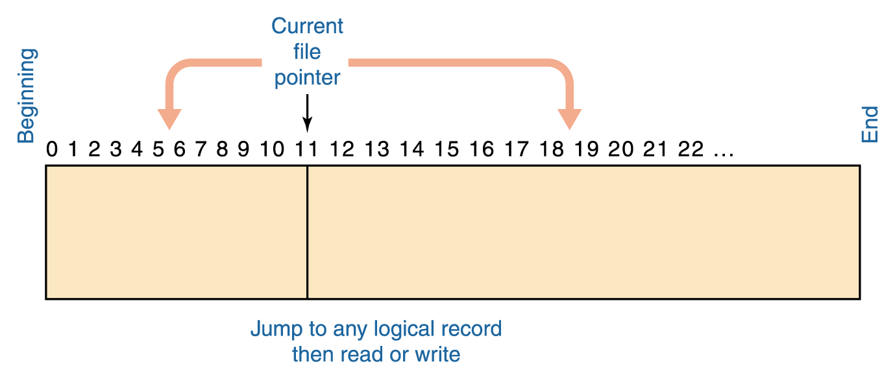
File Access
Figure 11.3 Direct file access

Slide 16
File Protection
File protection
The process of limiting file access
  In multiuser systems, file protection is of primary importance
  We don’t want one user to be able to access another user’s files unless the access is specifically allowed
  A file protection mechanism determines who can use a file and for what general purpose
Why is file protection important? Give two examples

Slide 17
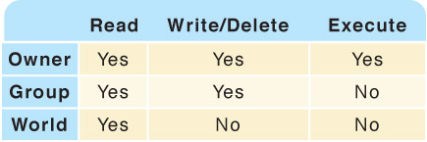
File Protection in Unix
An example of a file protection scheme is the file settings in the Unix operating system, which are divided into three categories

Slide 18
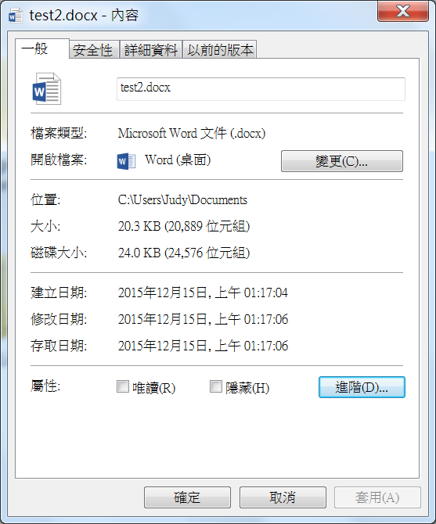
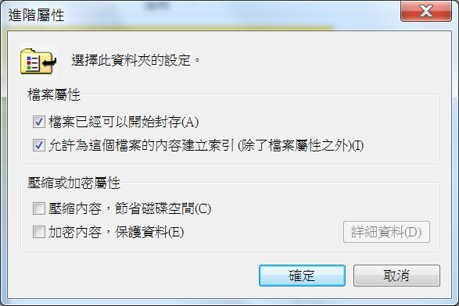
File Protection in Windows
鼠標移到檔案上按右鍵→內容

Slide 19
Directory Trees
Recall that a directory is a named group of files.
A directory can be contained within another directory
Directory
Edition 3
CSI PP Slides
Directory
…
Chapter01.ppt
Chapter17.ppt
Files

Slide 20
Directory Trees
Parent directory
The containing directory
Subdirectory
The directory being contained
Directory tree
A logical view of a file system; a structure showing the nested directory organization of a file system
Root directory
The directory at the highest level

Slide 21
Directory Trees
At any point in time, you can be thought of as working in a particular location (that is, a particular subdirectory)
Working directory
The subdirectory in which you are working

Slide 22
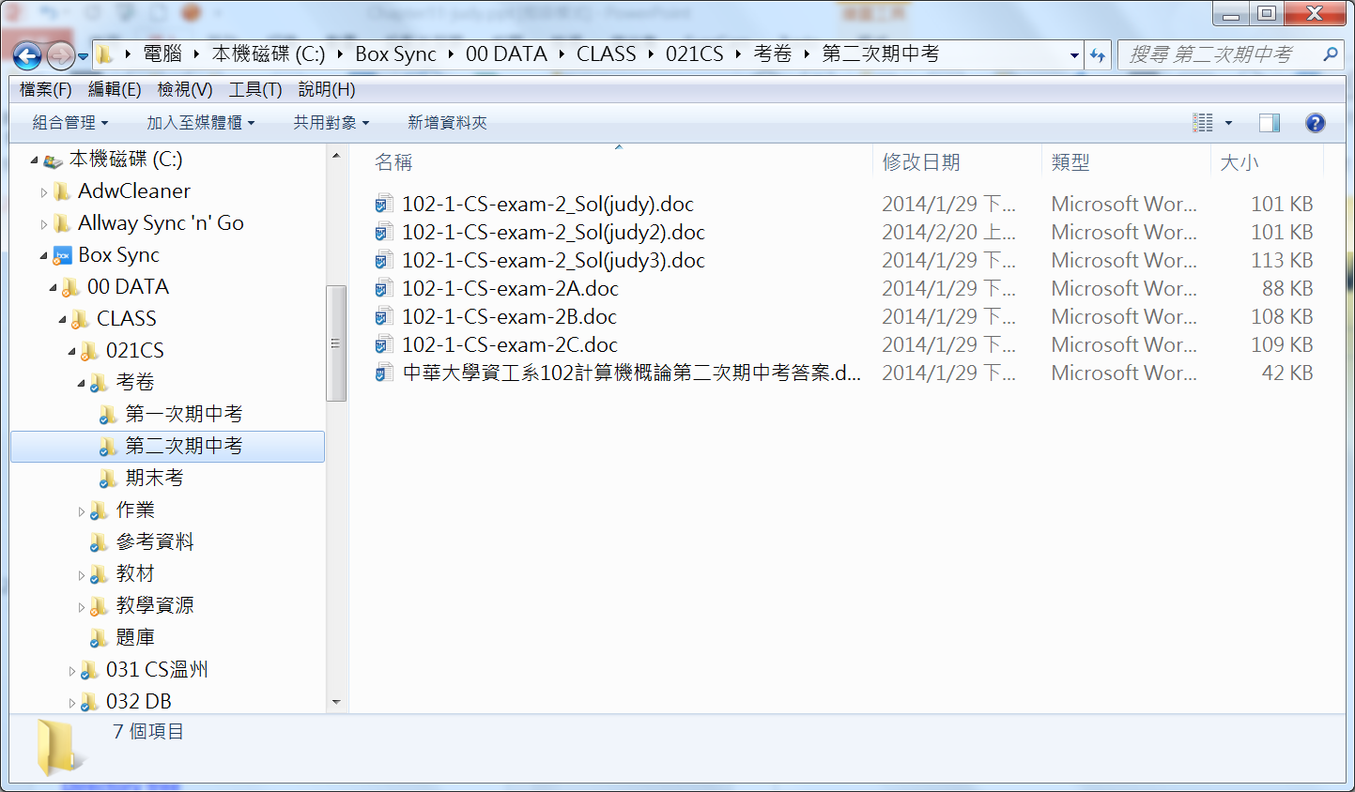
A Directory Tree in Windows
Root Directory
Parent directory of 第二次期中考
Files
Subdirectory of 考卷
Working directory
Directory tree

Slide 23
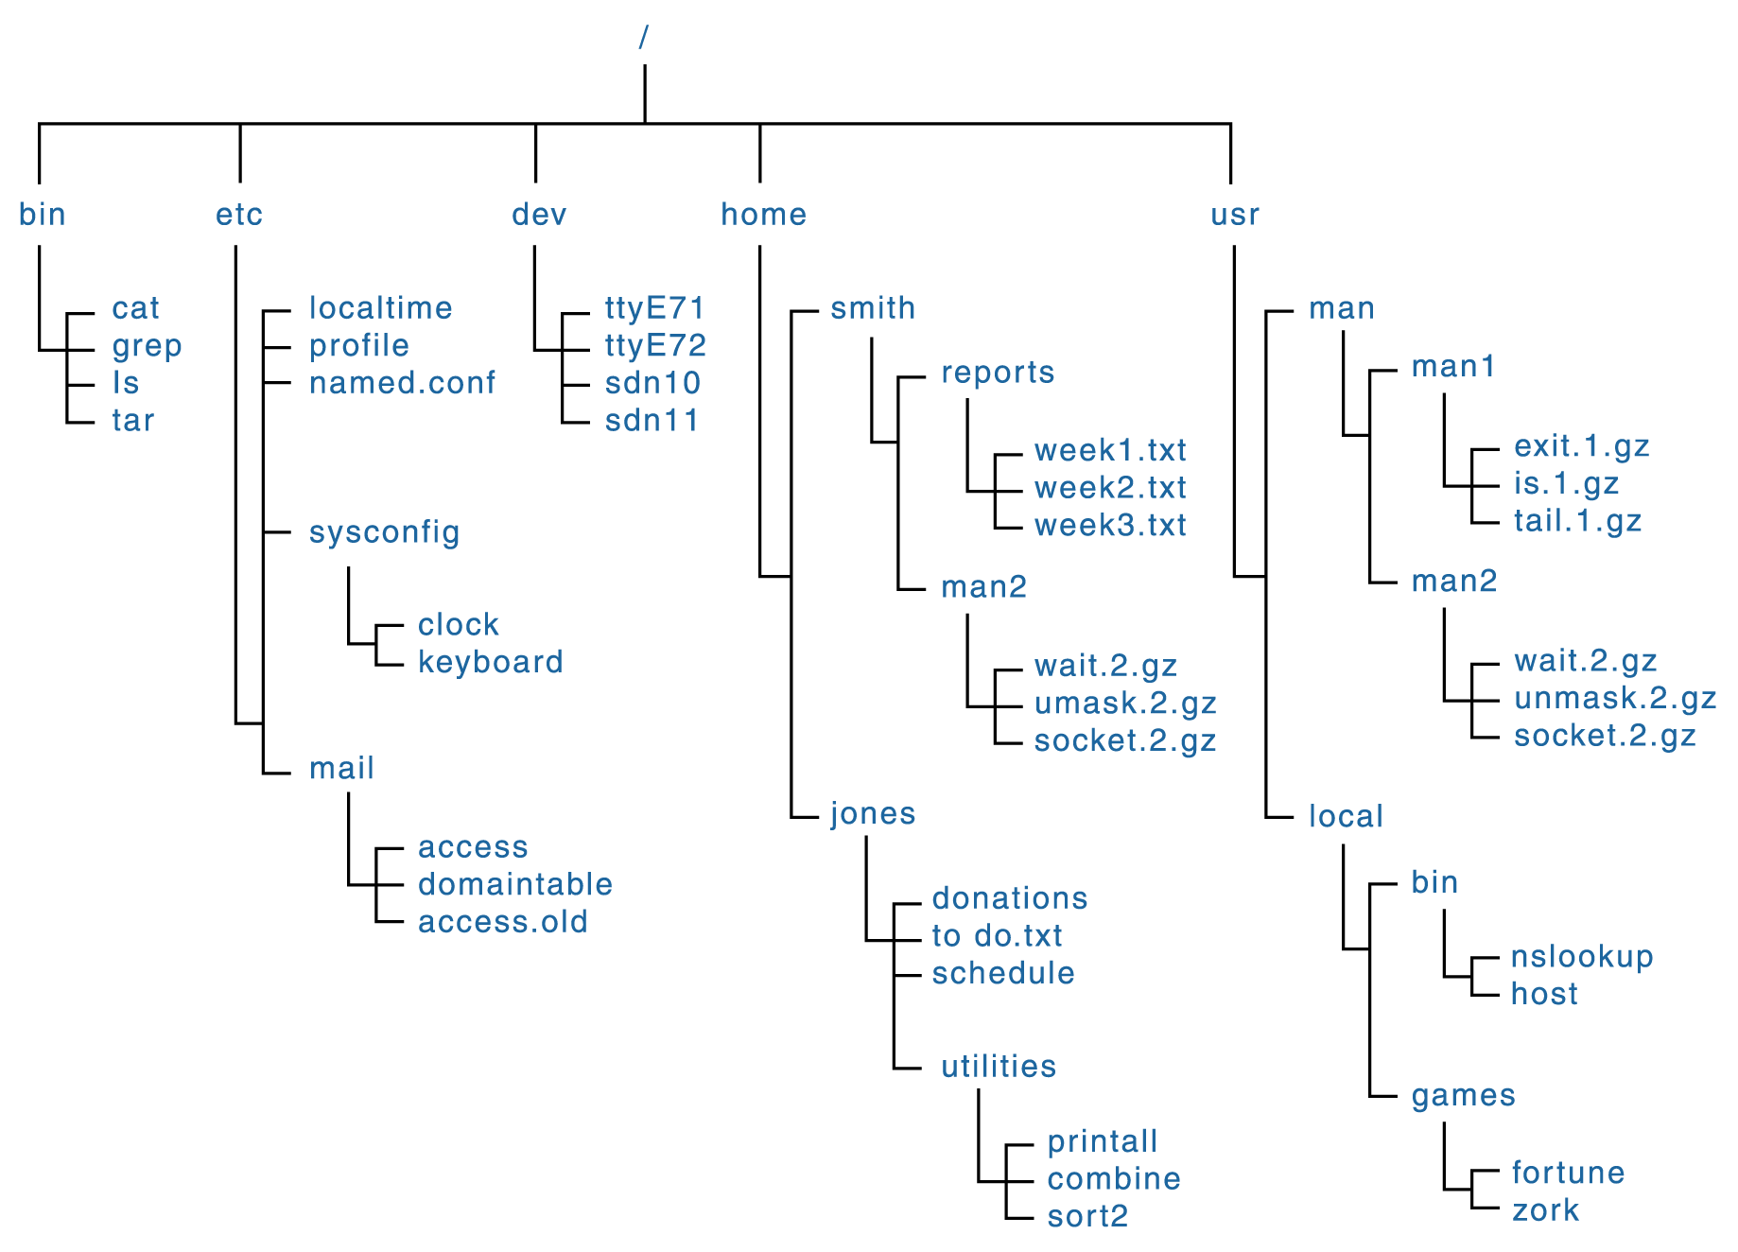
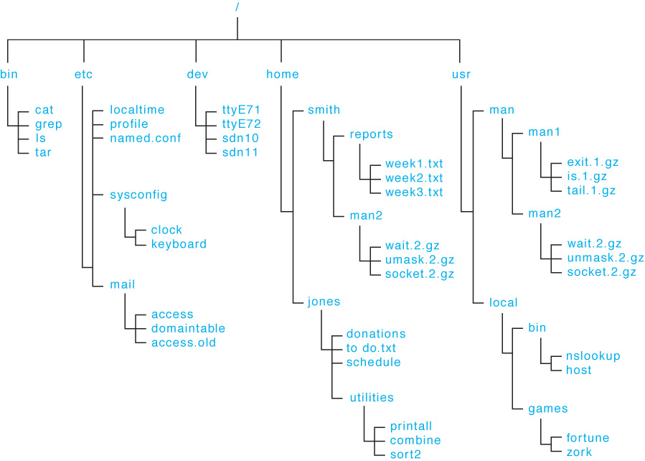
A Unix Directory Tree
Figure 11.5 A Unix directory tree
Figure 11.5 A UNIX directory tree

Slide 24
Path Names
Path(路徑)
A text designation of the location of a file or subdirectory in a file system
Absolute path
A path that begins at the root and includes all successive subdirectories
Relative path
A path name that begins at the current working directory

Slide 25
Path Names
Absolute paths
  C:\Program Files\MS Office\WinWord.exe
  C:\My Documents\letters\applications\vaTech.doc
  C:\Windows\System\QuickTime
If current working directory is
  C:\My Documents\letters
Relative paths
  applications\vaTech.doc
Distinguish
between
absolute and
relative
paths

Slide 26
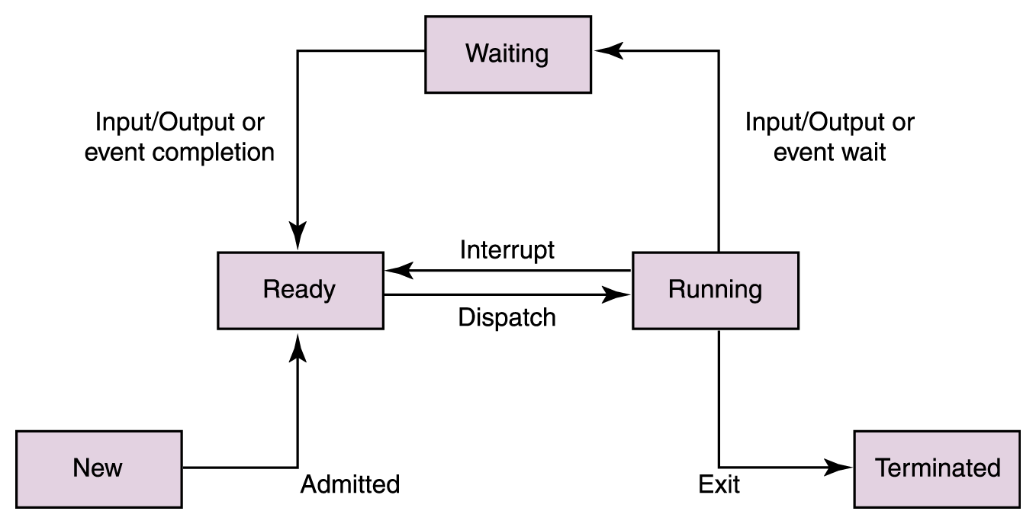
Disk Scheduling*
Processes are
waiting for I/O to
be performed.
Which of those
waiting should be
performed next?
Recall that I/O is
the slowest aspect
of any computing
system

Slide 27
Disk Scheduling*
As a computer deals with multiple processes over a period of time, a list of requests to access the disk builds up
Disk scheduling
The technique that the operating system uses to determine which requests to satisfy first

Slide 28
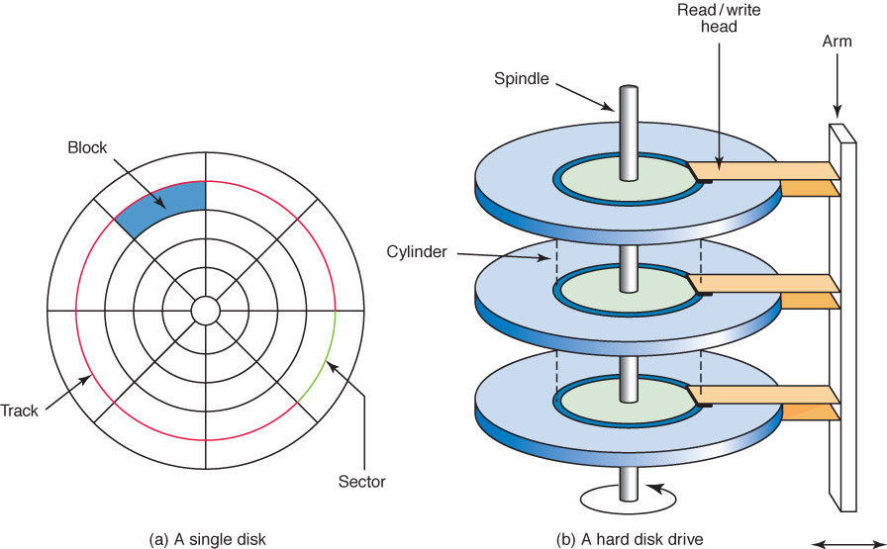
Disk Scheduling *
Figure 11.5
A magnetic disk drive
Remember seek time and latency?

Slide 29
Disk Scheduling *
First-Come, First-Served (FCFS)
Requests are serviced in the order they arrive, without regard to the current position of the heads
Shortest-seek-time-first (SSTF)
Disk heads are moved the minimum amount possible to satisfy a pending request
Scan
Disk heads continuously move in and out servicing requests as they are encountered
Sound familiar?

Slide 30
Disk Scheduling *
Ordered cylinder requests: 49, 91, 22, 61, 7, 62, 33, 35
Read/write heads at Cylinder 26
In what order are they serviced if no more
requests arrive?
FCFS:
SSTF:

Slide 31
Disk Scheduling *
SCAN Disk Scheduling works like an elevator
  An elevator is designed to visit floors that have people waiting. In general, an elevator moves from one extreme to the other (say, the top of the building to the bottom), servicing requests as appropriate
  The SCAN disk-scheduling algorithm works in a similar way, except instead of moving up and down, the read/write heads move in toward the spindle, then out toward the platter edge, then back toward the spindle, and so forth

Slide 32
Disk Scheduling *
Ordered cylinder requests: 49, 91, 22, 61, 7, 62, 33, 35
Read/write heads at Cylinder 26 moving toward cylinder 1
In what order are they serviced if no more
requests arrive?
SCAN

Slide 33
Ethical Issues
Spam
How many spam messages have you
received today?
Why is spam expensive?
Have you ever sent spam?
Explain the CAN-SPAM Act.

Slide 34

Do you know?
What is an RFID tag? What is it used for?
What is HRV? How can software be used to monitor and reduce stress?
What is the eNeighbor System?
How can it be used to monitor conditions of the elderly?
32

